Slide 1

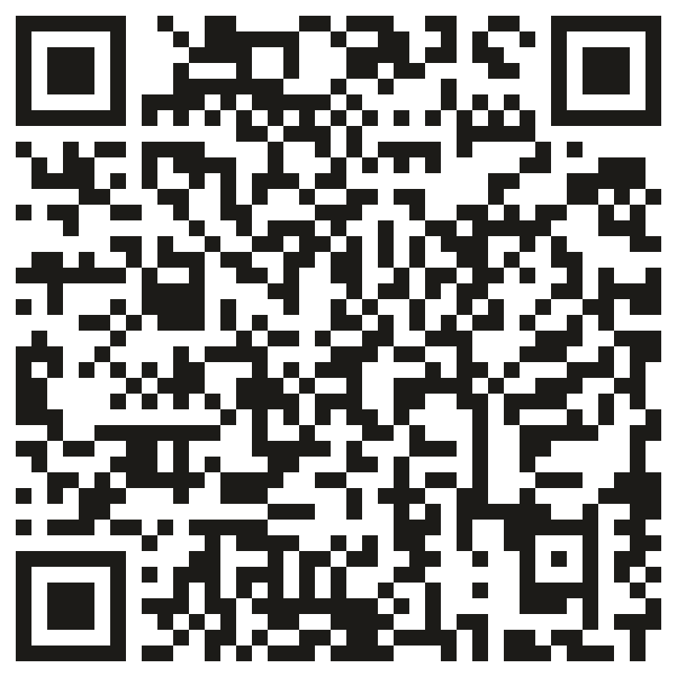
Fall 2026 · Group project
Sliced Bread
Add your income and I'll do the math.
A free budget tracker for students who have never kept a budget
Scan to try it
Opens the app on your phone or laptop
Mark Gurevich · Luke Lentini · Keira Parker · Jean Dorta · Liron Sellam
Notes:
Hi, we're Mark, Luke, Keira, Jean and Liron. This is Sliced Bread, a free budget tracker for students. Scan the code if you want to follow along on your phone; we'll do a live demo in a minute. First, why we built it.

Slide 2
Everyone says to budget. Most people don't.
64%
of Americans didn't make a budget in 2024. A quarter of them said past attempts didn't stick.
Who it's for
173M
US adults with no budget
37%
of US adults couldn't cover a surprise $400 bill with cash.
19.4M
US college students
$100
a year is what the good budgeting apps cost. Mint, the big free one, shut down in 2024.
2,000
UM, year one
Notes:
Almost two thirds of Americans didn't make a budget last year, and a quarter of them said they'd tried before and it didn't stick. More than a third of adults couldn't cover a $400 surprise with cash. The good apps cost about $100 a year, and Mint, the free one, shut down in 2024. Anyone without a budget could use ours, about 173 million US adults. We start with the 19.4 million college students setting up their first budget, and our goal for year one is 2,000 UM students, about 10% of campus. We count people, not dollars, because it's free.

Slide 3

Free, and there's nothing to learn
$0
1 page
No setup
Free for good
Easy to read
Start in seconds
No subscription, no trial, no card. You don't link a bank account either.
Income at the top, then needs, wants, investing and savings: the order money moves.
Sign in with a name and type your first line. Pick a plan like 50/30/20 only if you want one.
What it does
Spending limits
Percentage targets
History chart
Amber at 90%, red when you're over
Type three shares; it fills in the fourth
Months side by side; click to zoom in
Savings goal
Your own categories
A duck
Progress across every month
Add things like Pets or Gym
One line on how your month is going
Notes:
Three things make it different. It's free, with no card and no bank login. It's one page you read top to bottom in the order money moves. And there's nothing to set up: sign in and type your first line. Underneath that it has spending limits that change colour, percentage targets, a history chart, a savings goal, your own categories, and the duck. We'll show all of it in the demo.

Slide 4
Four boxes that have to add up to 100
1
Match boxes to categories
def parse_targets(needs_text, wants_text, investing_text, savings_text):
typed = dict(zip(CATEGORIES, (needs_text, wants_text, investing_text, savings_text)))
if all(is_blank(text) for text in typed.values()):
return {}
targets = {}
for key, text in typed.items():
targets[key] = target_number(text)
if targets[key] is None:
raise ValueError(f"{CATEGORY_NAMES[key]} must be a whole number from 0 to 100")
total = sum(targets.values())
if total != PERCENT_WHOLE:
raise ValueError(f"Targets must add up to 100% (now {total}%)")
return targets
def category_limits(settings):
overall = settings["limits"].get("overall", 0)
targets = settings.get("targets", {})
if overall <= 0 or set(targets) != set(CATEGORIES):
return {}
return {category: share_of(overall, targets[category]) for category in CATEGORIES}
zip pairs the four boxes with Needs, Wants, Investing and Savings.
1
2
2
All blank? Targets are off
3
They're optional, so empty boxes aren't an error.
3
Check every box
4
Not a whole number from 0 to 100? The error names the box.
4
Must add up to 100
The message tells you where you are: "(now 95%)".
5
Percent becomes dollars
With a monthly limit set, each category gets its share. The meters fill against it.
5
From budget.py (docstrings removed)
Notes:
This is what runs when you set your targets on the Goals tab. You type four percentages, one for each category. zip pairs each box with its category. If all four are blank, targets are simply off. Then it checks each box is a whole number from 0 to 100, and the error message names the box that's wrong. The four have to add up to 100, and if they don't, the message tells you the current total. The second function turns those percentages into dollars: if your monthly limit is $2,000 and Needs is 45%, Needs gets $900, and that's what its meter fills against. It uses functions, dictionaries, zip, loops, if statements and exceptions.

